Slide 1
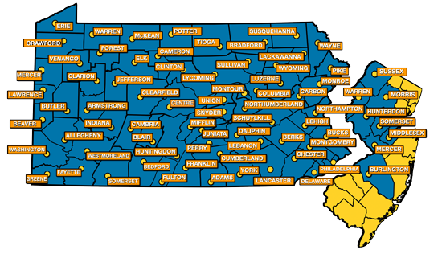
Service, Access & Management, Inc.
Berks Co. MH Supports
www.sam-inc.org

Slide 2
Objectives
* What is Service Access & Management.
* How to submit a referral to the Base Service Unit.
* Exploring Mental Health Case Management.

Slide 3
WHO is SAM, INC.? Service, SAM, Inc.= Access & management
We are…..
A provider of human services
A provider of management, consultative & administrative services available for contract.
SAM, Inc. is found in 2 states:
PA & NJ
Between PA & NJ, SAM, Inc.
has a presence within
70 counties.

Slide 4
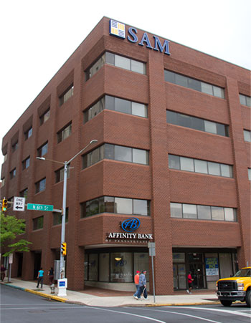
Office Locations
SAM, Inc.’s staff members are primarily mobile
All staff have agency issued mobile phones and
laptops equipped with a variety of applications
and software
SAM reorganized in 2020 into Service Lines
(groupings of similar services) versus Sites
(locations) with Welcome Centers (17)
Reading, PA
Berks Main Office:
19 N. 6th Street
* BSU Intake-Berks.

Slide 5
Service array : berks
1. Truancy (ASAP)
2. IDD Supports Coordination
3. Early Intervention Service Coordination
4. Targeted Case Management
5. Housing
6. OLTL
7. Administrative Entity
8. Base Service Unit
9. CHIPP

Slide 6
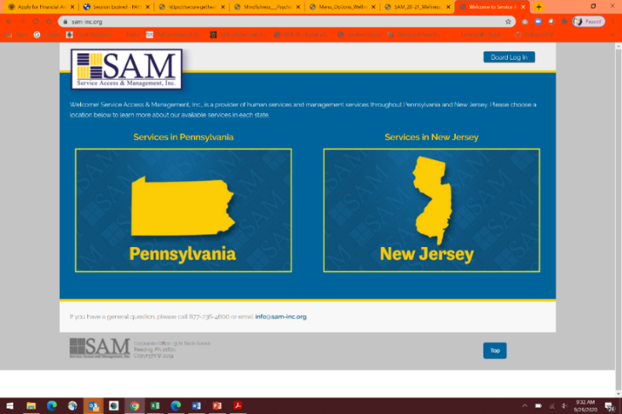
Contact Information
Main Phone
610.236.0530
Website:
www.sam-inc.org

Slide 7
Base Service Unit (BSU): Intake
Serves adults and children
Offers referrals, resources & information about programming & agencies available in the community
Performs intakes/assessing eligibility for programming (County funded mental health services)
Intakes/Screening performed on a Walk-in basis 8am-1pm, Monday- Friday
Mobile Intakes and Community Outreaches are available.
Provide Choice on Case Management Providers within the community.
BSU Referrals: (Consumer’s Name, Phone Number, & Address)
Call Main Line: 610-236-0530
Email: berksintake@sam-inc.org
INSERT LINK
Notes:
Discuss COVID changes to operations. Explain liability

Slide 8
Base Service Unit (BSU): Intake
In order for intake/base service unit staff to assist most efficiently:
1. Individuals should bring diagnostic information, if available. This would include any paperwork the individual has after receiving treatment that lists a mental health diagnosis. Please note that certain services require signatures from personnel as outlined in regulation, such as case management, which requires a Licensed Practitioner of the Healing Arts (LPHA). Staff members at SAM can work with the mental health treatment provider to coordinate the receipt of the needed signature(s).
2. Income information, is also needed, so that a liability can be calculated per PA regulation. A liability is the monthly amount that may be required to receive certain County funded services. The liability is completed based off of income and other factors. The type of service that requires a liability calculation is outlined in PA regulation.
3. Intake appointments generally take 1 hour.

Slide 9
Mental health services: county funded
1. Social Recreational –Drop In Center (Circle of Friends)
2. Representative Payee (GRMHA)
3. Psychiatric Rehabilitation (Clubhouse) – Mosaic House (Adults) and Hope Springs (Transition Age Youth)
4. Crisis Intervention & Emergency Services (including court coordination, transportation & MHRO hearing costs)
5. MH Case Management
6. MH Forensic Case Management
7. Community Residential Rehabilitation (CRR) Host Home Room & Board for Youth
8. CRR for Adults
9. Outpatient
10. Inpatient
11. Family Based Mental Health (FBMH)
12. Partial Hospitalization Programming (PHP)
13. Assertive Community Treatment (ACT)
14. Housing
15. Respite (Reinvestment monies via Health Choices)
16. Supported Employment
17. Vocational Rehabilitation
18. Forensic Employment Services
19. Forensic CRR (Project Transition)
20. Abraxas Detention Center-onsite Outpatient
21. Student Assistance Program (SAP-coordinated by COCA & provided by CHS, Reading Hospital/Tower & Caron)
22. Forensic Diversion
23. NAMI local chapter
24. Community Hospital Integration Projects Program (CHIPP)
25. Kids Against Pressure
26. RTFA
27. Other ancillary programming (ICAN, ICAN WeSH, etc)
28. Supported Living

Slide 10
Blended Case management
Mental Health (MH)
For Children and Adults
Adult Forensic Case Management- must be on Probation/Parole.
On-line referral process for providers- https://sam-inc.org/referralform/
Notes:
Blended Case Management is available for eligible children who have behavioral/social-emotional/mental health issues, and adults with severe mental illness. Our intake staff work with individuals to establish eligibility and to determine the appropriate level of support.
Eligibility for adults: diagnosed serious and persistent mental illness
Eligibility for children and adolescents under 21 years: diagnosed mental illness or serious emotional disturbance
IDD Supports Coordination is available for individuals over the age of three years. Eligibility criteria: IQ score of 70 or below with “deficits in adaptive behavior in three or more areas.”
EI Service Coordination is available for infants/toddlers 0-3 years old with developmental delay of cognitive, communication, social/emotional, physical and adaptive. Criteria is 25% delay in at least one of these developmental areas.

Slide 11
Case Management
Goal:
To increase independence by empowering individuals to meet their recovery and life goals that they identify
Coordination of services
Partnership
Planning
Linkage and Referral
Prevent and Manage Crises
Advocacy
Notes:
Partnership - Establishing a partnership with the person served and/or his/her parent(s)/guardian(s) which offers respect, support, and collaboration, and results in trust and hope.
Planning - Completing planning which is individualized, comprehensive, and holistic in addressing the various domains of the consumer’s life;
All plans are developed following an assessment of the individual’s or family’s (in the case of a child) strengths/abilities, needs, and preferences/interests. Plans indentify specific and measurable personal goals/outcomes and the objectives/activities necessary to achieve them.
Linkage and Referral – CM Links and refers to chosen treatment, other services, natural supports, and other community resources and opportunities as specified in the individual’s service plan.
Prevent and Manage Crisis - This includes providing assistance to individuals in identifying mental health problems and needs, and resolving and/or diffusing crisis situations through problem-solving, support, and referral.
Advocacy – CM’s support individuals/families in developing their own voices.

Slide 12
Funding for case management
Provided at no cost to an eligible individual.
Case Management Services are funded by:
Community Care Behavioral Health (CCBH) & other MCO’s
Medical Assistance Fee for Service
SAM, Inc. by virtue of State funding through the MH/DD Program
Commercial insurance generally does not fund CM.
State
Berks MH/DD
SAM, Inc.
Provider of Case Management

Slide 13
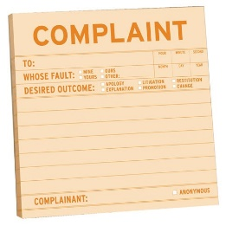
Contact Information
Mailing Address:
19 North Sixth Street, Reading, PA 19601
Phone (Main):
610-236-0530
Website: www.sam-inc.org
SAM, Inc. Complaint/HelpLine: 1-877-780-0681
Notes:
SA

Slide 14
Questions?
Please feel free to ask questions during these sections of the presentation.

