Slide 1
Introduction to Crisis Assessment & Intervention
Presenter Bill Baker

Slide 2
“Cops Retaliate on Veteran Using 5150”

Slide 3
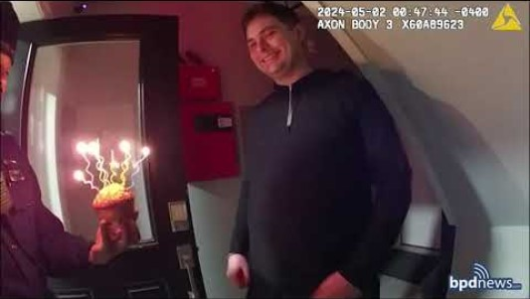
Birthday in Boston

Slide 4
What does a Mental Health Crisis look like?
Crisis is different for every individual.
Can be as apparent and obvious as experiencing delusions and hallucinations or as simple as a loss of hope.
The underlying issue most common to crisis is loss of control.
Thoughts
Emotions
Am I the right person to help here?
How do I remain controlled?

Slide 5
Key Factors in Assessing MH Calls
Show respect, build trust.
Does what you are seeing reflect what is being said?
Have we been here before?
What does the respondent need?
How am I presenting myself?
Do I have a plan for what happens next?
“I don’t care what’s wrong with you, I want to know what happened to you”.
“Listen to understand, not to be understood”.

Slide 6
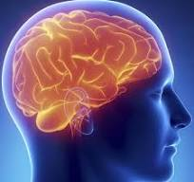
Brain functions during crisis
Oxygen and logical thought are diminished.
Blood flow is re-directed.
Breathing becomes shallow.
Work toward re-directing the thought process.

Slide 7
Teaming
As you communicate, do so in a way that intimates that we are in this together.
Blend
Redirection

Slide 8
Most Critical CIT Officer Actions
Develop Authentic Connection
Active Listening
Calm and Steady Speech
Managing YOUR Emotions
Solicit Individuals’ Reality and Emotions
Express Empathy- their reality is real to them

